Slide 1


Add a new starter in Kestrel HR
26 September 2026 · 13 steps
Yellow box = click here. The magnified panel shows the same spot up close.

Slide 2
✍ NOTE · Step 1 Before you start
Before you start
You need the HR Advisor role in Kestrel HR.
Have the signed offer letter to hand: the name, department and contract type must match it.
Practise with test data only, never a real person's details.
Policy: Onboarding and induction procedure, v3.2

Slide 3
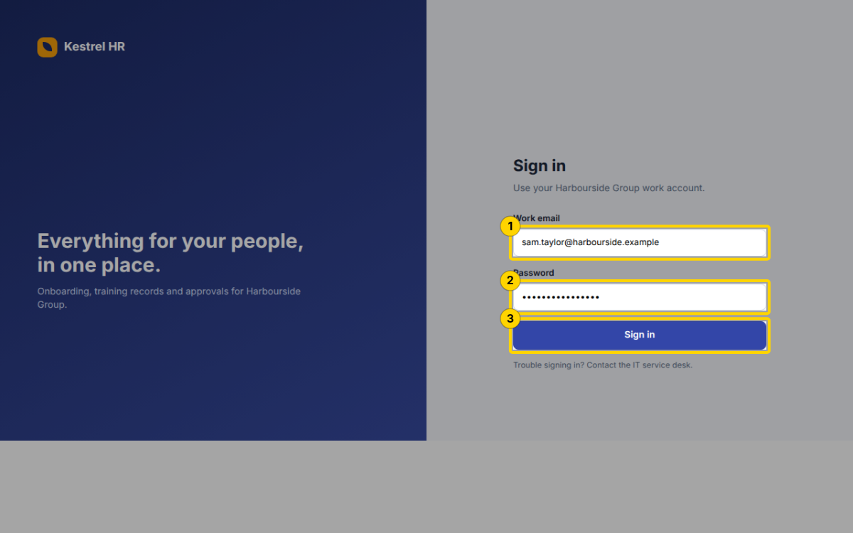
Step 2 — Complete the following steps
Enter sam.taylor@harbourside.example in Work email
Enter your Password
Click the Sign in button
Sign in · Kestrel HR · http://hr.harbourside.example:8800/ · textbox · 26 Sept 2026, 10:49

Slide 4
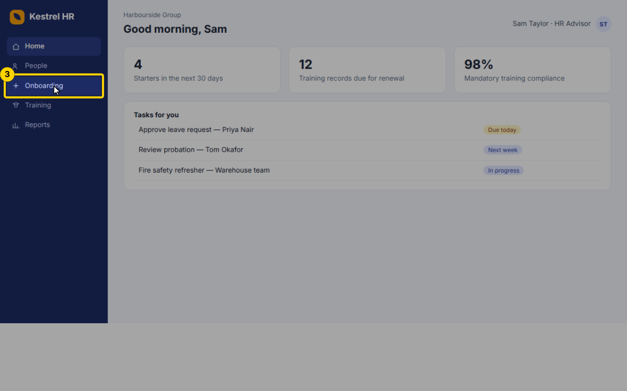
Step 3 — In the menu, click Onboarding
Home · Kestrel HR · http://hr.harbourside.example:8800/#home · link · 26 Sept 2026, 10:49

Slide 5
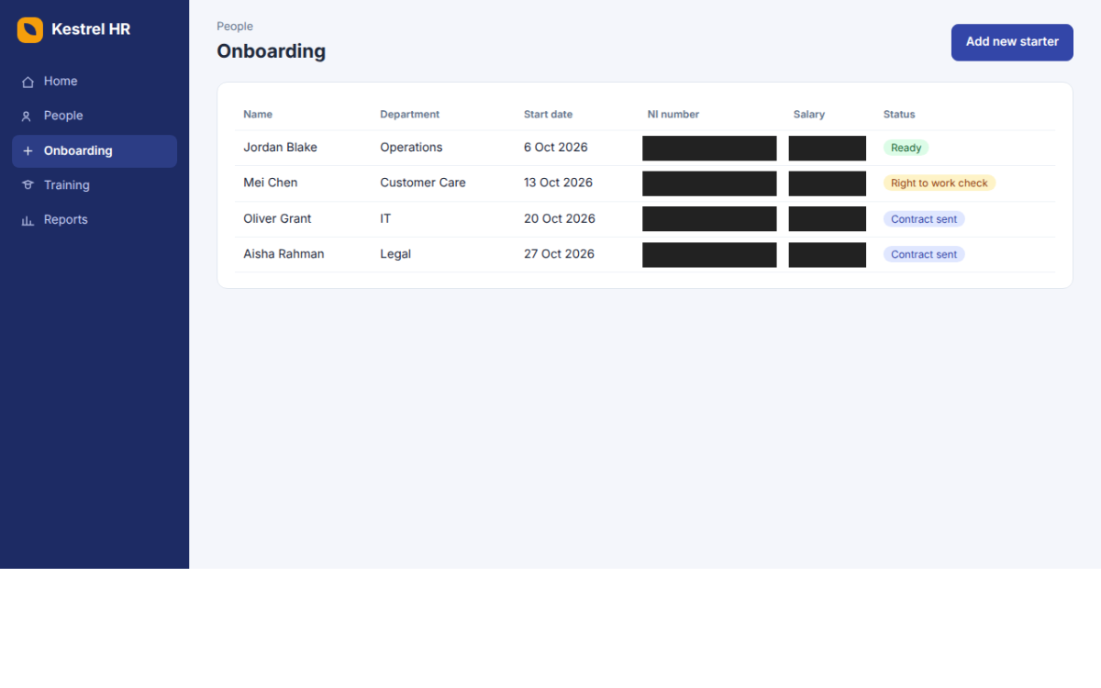
Step 3 · Result — In the menu, click Onboarding

Slide 6
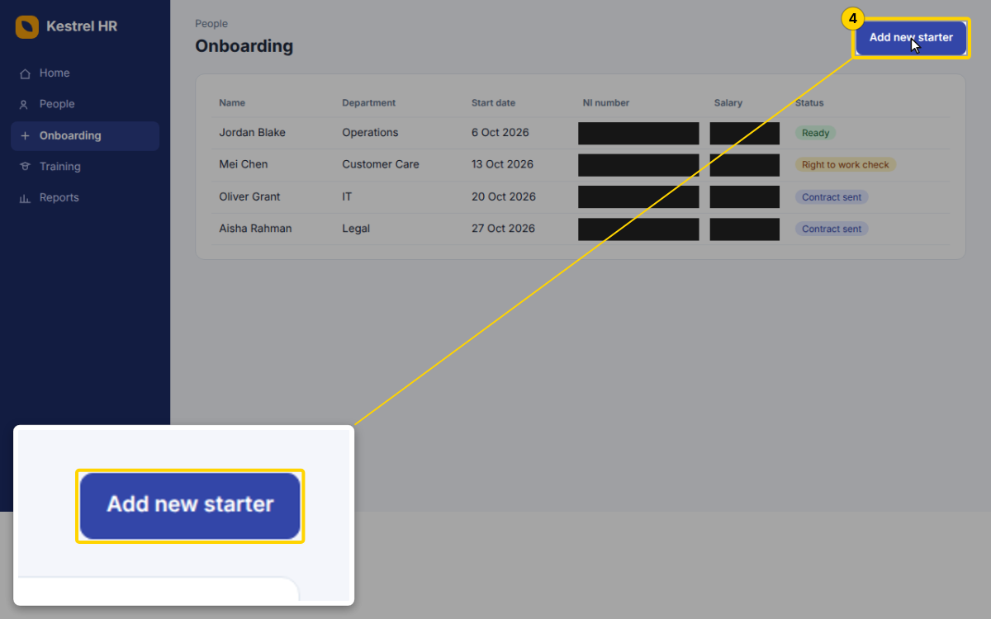
Step 4 — Click the Add new starter button
Onboarding · Kestrel HR · http://hr.harbourside.example:8800/#onboarding · button · 26 Sept 2026, 10:49

Slide 7
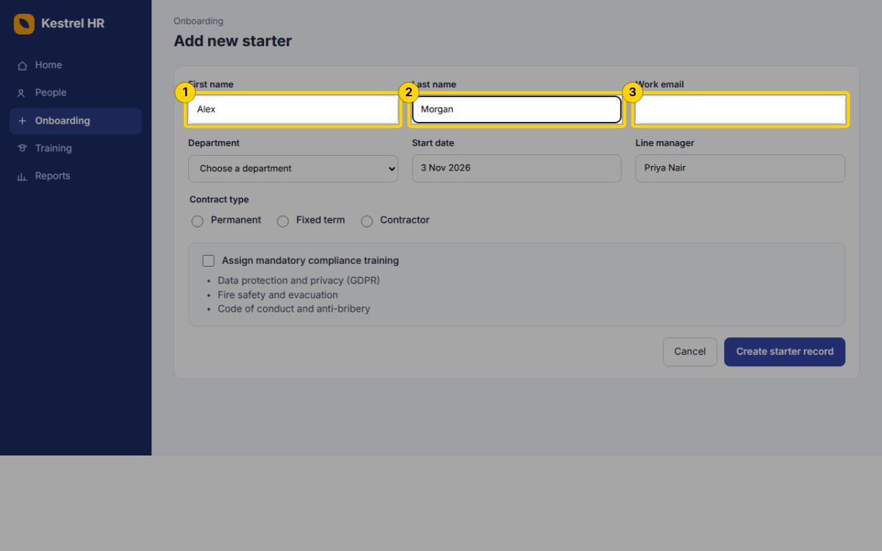
Step 5 — Complete the following steps
Enter Alex in First name
Enter Morgan in Last name
Enter alex.morgan@harbourside.example in Work email
Add new starter · Kestrel HR · http://hr.harbourside.example:8800/#onboarding/new · textbox · 26 Sept 2026, 10:49

Slide 8
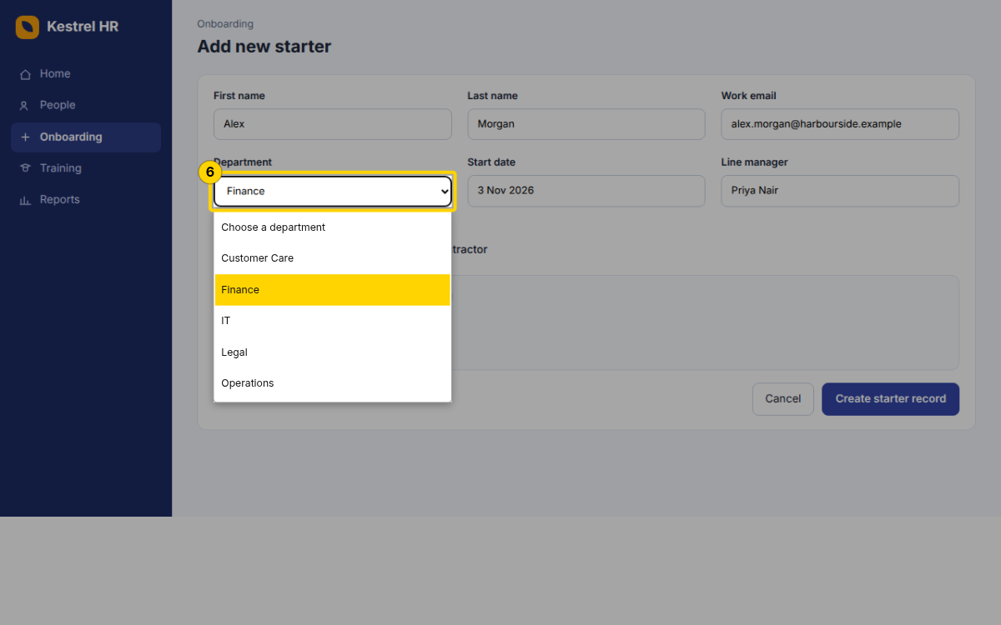
Step 6 — Choose Finance from Department
Add new starter · Kestrel HR · http://hr.harbourside.example:8800/#onboarding/new · combobox · 26 Sept 2026, 10:49

Slide 9
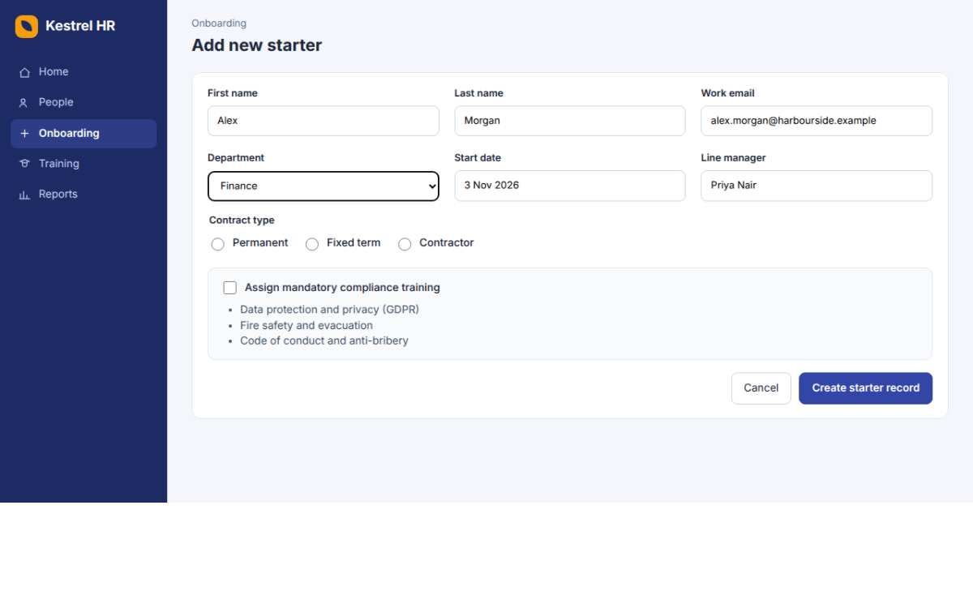
Step 6 · Result — Choose Finance from Department

Slide 10
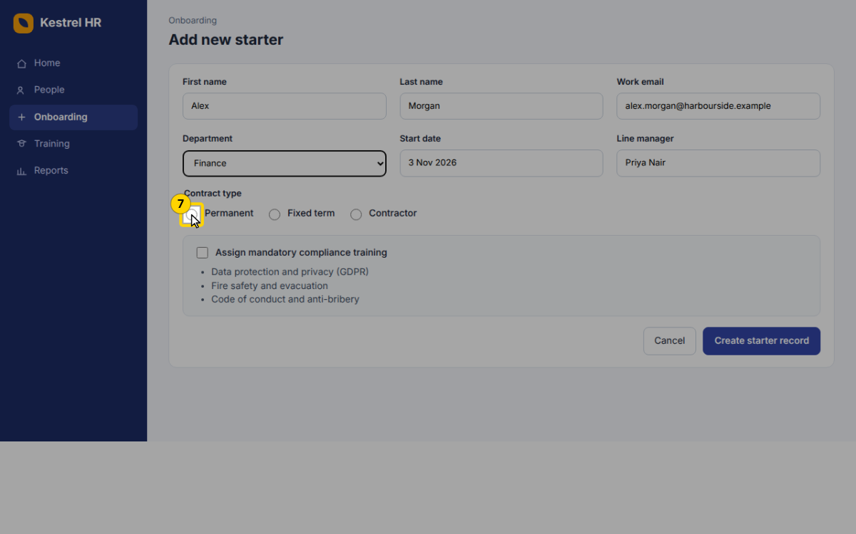
Step 7 — Under Contract type, select Permanent
Add new starter · Kestrel HR · http://hr.harbourside.example:8800/#onboarding/new · radio · 26 Sept 2026, 10:50

Slide 11
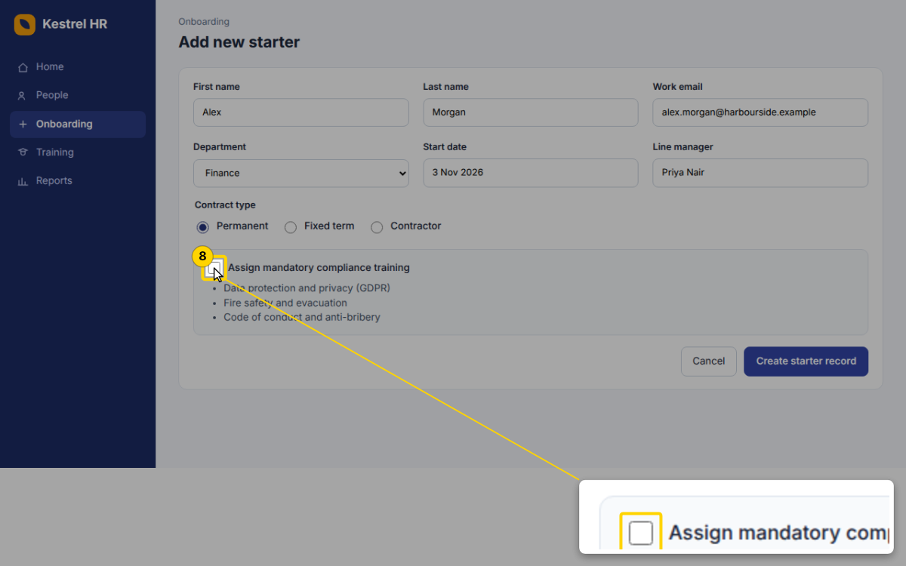
Step 8 — Tick Assign mandatory compliance training
Add new starter · Kestrel HR · http://hr.harbourside.example:8800/#onboarding/new · checkbox · 26 Sept 2026, 10:50

Slide 12
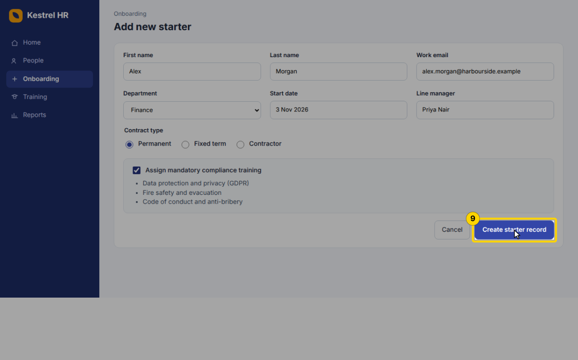
Step 9 — Click the Create starter record button
Add new starter · Kestrel HR · http://hr.harbourside.example:8800/#onboarding/new · button · 26 Sept 2026, 10:50

Slide 13
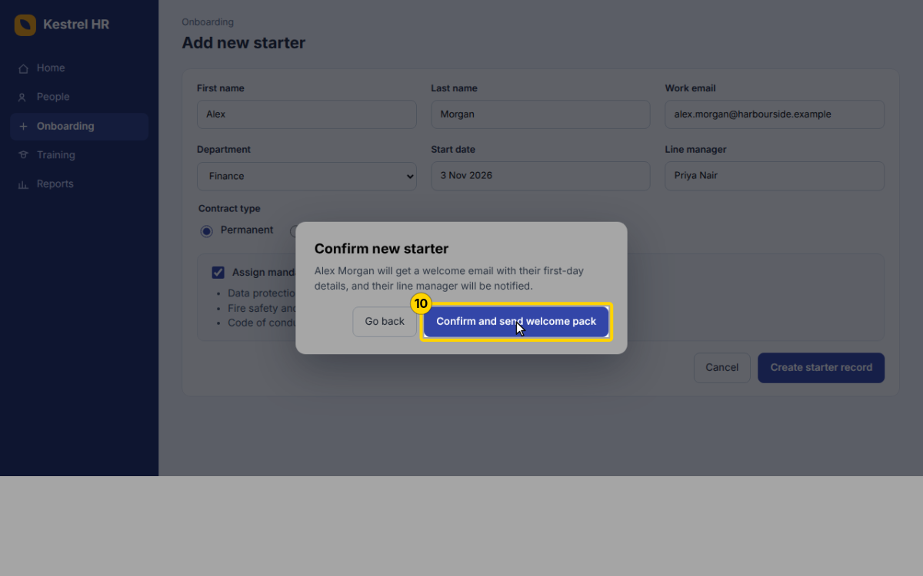
Step 10 — In the Confirm new starter dialog, click Confirm and send welcome pack
Add new starter · Kestrel HR · http://hr.harbourside.example:8800/#onboarding/new · button · 26 Sept 2026, 10:50

Slide 14
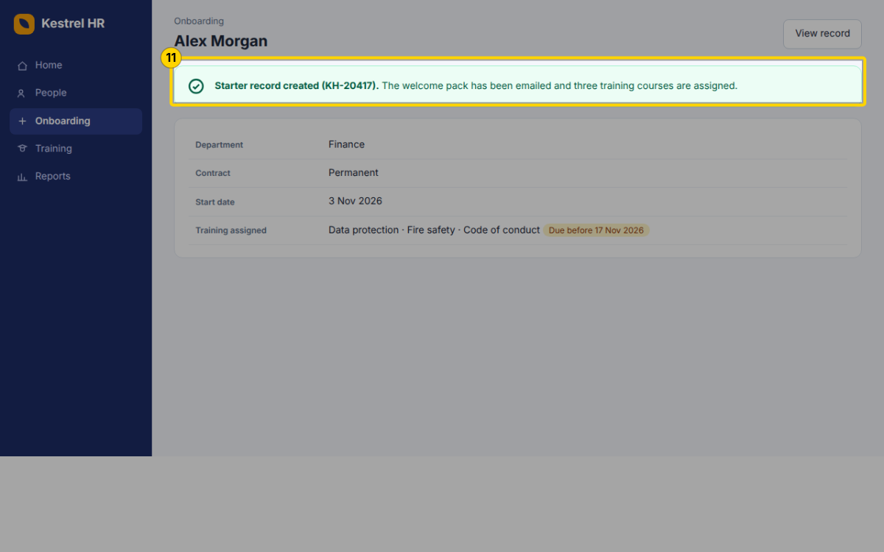
Step 11 — Check the green banner: the record number (KH-20417) confirms the starter record was created and the training was assigned
Alex Morgan · Kestrel HR · http://hr.harbourside.example:8800/#onboarding/KH-20417 · manual · 26 Sept 2026, 10:50

Slide 15
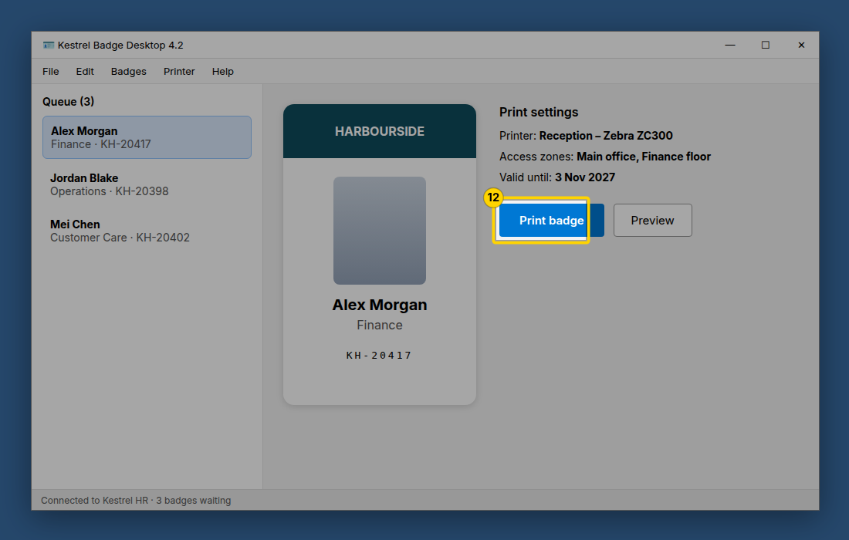
Step 12 — In Kestrel Badge Desktop, select the new starter and click Print badge
manual · 26 Sept 2026, 10:50

Slide 16
✍ NOTE · Step 13 What happens next
What happens next
Alex gets the welcome pack by email today.
The three compliance courses are due before 17 Nov 2026; Kestrel HR sends reminders.
Questions: people@harbourside.example

